Slide 1
Monetary Policy & the Economy
Aditi Chaubal
aditi@hss.iitb.ac.in
HS101 – Economics (Macroeconomics) - 2018

Slide 2
This chapter covers…
Monetary policy and the economy
Reserve Bank of India (RBI) – Aims, Functions, Balance sheet, Targets, Instruments
Monetary policy instruments
Reserve requirements
Monetary policy: Transmission mechanism
Liquidity trap
Monetary economics applications: Monetarism and Quantity theory of money and prices
HS101 – Economics (Macroeconomics) - 2018

Slide 3
The Objectives in the Preamble
The Preamble of the Reserve Bank of India describes the basic functions of the Reserve Bank as:
“to regulate the issue of Bank notes and keeping of reserves with a view to securing monetary stability in India and generally to operate the currency and credit system of the country to its advantage; to have a modern monetary policy framework to meet the challenge of an increasingly complex economy, to maintain price stability while keeping in mind the objective of growth.”
HS101 – Economics (Macroeconomics) - 2018

Slide 4
The Objectives of the Reserve Bank of India (RBI)
Primary role: monetary stability
to sustain confidence in the value of the country’s money or preserve the purchasing power of the currency
=> low and stable expectations of inflation, whether that inflation stems from domestic sources or from changes in the value of the currency, from supply constraints or demand pressures.
Mandate of inclusive growth and development
Mandate of financial stability
HS101 – Economics (Macroeconomics) - 2018

Slide 5
The role and functions of RBI
Role | Function | Objectives
Monetary authority | Formulates, implements and monitors the monetary policy. | Maintaining price stability while keeping in mind the objective of growth.
Regulator and supervisor of the financial system | Prescribes broad parameters of banking operations within which the country's banking and financial system functions. | Maintain public confidence in the system, protect depositors' interest and provide cost-effective banking services to the public.
Manager of Foreign Exchange | Manages the Foreign Exchange Management Act, 1999. | To facilitate external trade and payment and promote orderly development and maintenance of foreign exchange market in India.
Issuer of currency | Issues and exchanges or destroys currency and coins not fit for circulation. | To give the public adequate quantity of supplies of currency notes and coins and in good quality.
HS101 – Economics (Macroeconomics) - 2018

Slide 6
The role and functions of RBI
Role | Function | Objectives
Developmental role | Performs a wide range of promotional functions to support national objectives. | Inclusive growth and development.
Banker to the Government | Performs merchant banking function for the central and the state governments; also acts as their banker. | To facilitate transactions of government including raising resources from the public
Banker to banks | Maintains banking accounts of all scheduled banks. | To enable seamless clearing and settlement of interbank transactions Provide an efficient means of funds transfer for banks Enable banks to maintain their accounts with the RBI for statutory cash reserve requirements and maintenance of transaction balances Acting as a lender of last resort
HS101 – Economics (Macroeconomics) - 2018

Slide 7
Composition
Governor + 4 Deputy Governors (DG)
The Monetary Policy Committee (MPC) constituted by the Central Government in 2016 determines the policy interest rate required to achieve the inflation target; meet at least 4 times a year.
Governor of the Reserve Bank of India – Chairperson, ex officio;
Deputy Governor in charge of Monetary Policy – Member, ex officio;
One officer of the RBI to be nominated by the Central Board – Member, ex officio;
Prof. Chetan Ghate, Professor, Indian Statistical Institute (ISI), New Delhi – Member;
Prof. Pami Dua, Director, Delhi School of Economics – Member; and
Prof. Ravindra H. Dholakia, Professor, Indian Institute of Management, Ahmedabad – Member.
The Financial Market Committee (FMC) meets daily to review the liquidity conditions so as to ensure that the operating target of monetary policy (weighted average lending rate) is kept close to the policy repo rate.
HS101 – Economics (Macroeconomics) - 2018

Slide 8
Different types of Monetary Policies
Monetary targeting (1985-1998):
A monetary reserve target is made consistent with the expected real GDP growth and a stable level of inflation. The framework is flexible and allowed for various feedback effects. The weakening of monetary targeting framework, both in advanced and developing countries, triggered a search for alternate monetary frameworks.
IMF classification of a monetary aggregate target: The monetary authority uses its instruments to achieve a target growth rate for a monetary aggregate, such as reserve money, M1, or M2, and the targeted aggregate becomes the nominal anchor or intermediate target of monetary policy.
HS101 – Economics (Macroeconomics) - 2018

Slide 9
Different types of Monetary Policies
Multiple Indicator approach (multiple objectives approach):
General goals of monetary policy such as maintaining economic stability, with specific goals of low+stable inflation, low unemployment, etc.
India (1998-2011): The approach was conceptualized by the then RBI Governor, Dr. Bimal Jalan
Augmented by forward looking indicators drawn from the Reserve Bank’s industrial outlook survey, capacity utilization survey, professional forecasters’ survey and inflation expectations survey. These indicators were then used to project growth, inflation, and broad money (M3), in order to make “the resource balance in the economy consistent with the credit needs of the government and the private sector. (This)… framework of monetary policy is termed as an augmented multiple indicators approach”. – Mohanty, D. (2010)
HS101 – Economics (Macroeconomics) - 2018

Slide 10
Different types of Monetary Policies
Inflation targeting (Jan 2014-):
Countries have explicit inflation targets. Central banks directed to ensure that inflation stays within mandated range
Inflation-targeting framework (as per IMF classification):
This involves the (i) public announcement of numerical targets for inflation, with (ii) an institutional commitment by the monetary authority to achieve these targets, typically over a medium-term horizon.
Additional key features include increased communication with the public and the markets about the plans and objectives of monetary policymakers and increased accountability of the central bank for achieving its inflation objectives.
Monetary policy decisions are often guided by the deviation of forecasts of future inflation from the announced inflation target, with the inflation forecast acting (implicitly or explicitly) as the intermediate target of monetary policy.

Slide 11
Central Bank Independence
Arguments in favour of independence | Arguments against independence
Political pressures; Political business cycle => expansionary policies prior to elections (long-term vs. short-term horizon) | Lack of accountability of the central bank actions
Government pressure to finance budget deficits | Unelected officials at central banks
Probable lack of expertise of politicians | Probable lack of coordination with fiscal policy
Central bank can end up taking blame
RBI independence
The RBI is an independent agency. While it consults with the government it decides monetary policy according to its own views and analysis about the nation’s economic interests (long-term horizons).
The RBI can note the advice of the government but does not have to comply independently chooses the path it deems best for the country.
Recent debate (October 2018)
HS101 – Economics (Macroeconomics) - 2018

Slide 12
Monetary Policy
Monetary policy: A policy (usually implemented by the central bank) to impact the money supply (and thus, the credit, interest rates and output) in the economy which can affect the macroeconomic goals of increasing growth, reducing unemployment and having stable inflation.
RBI definition: Monetary policy refers to the policy of the central bank with regard to the use of monetary instruments under its control to achieve the goals specified in the Act (RBI Act, 1934).
Instruments/tools: Interest rates, open market operations, reserve requirements
Interactions between money supply, interest rates, output, inflation, external sector
HS101 – Economics (Macroeconomics) - 2018

Slide 13
Important terms
Bond:
A debt instrument in which an investor loans money to an entity (typically corporate or government) which borrows the funds for a defined period of time at a variable or fixed interest rate.
Bonds are used by companies, municipalities, states and sovereign governments to raise money to finance a variety of projects and activities. Owners of bonds are debt holders, or creditors, of the issuer.
Difference between securities and bonds
Wide variety of financial assets (stocks, bonds, options, etc.)
HS101 – Economics (Macroeconomics) - 2018

Slide 14
Important terms
Government Security (G-Sec) or gilt-edged instruments
A tradeable instrument created and issued by the Central Government or the State Governments for the purpose of raising a public loan or for any other purpose as may be notified by the Government in the Official Gazette.
It acknowledges the Government’s debt obligation.
Short-term duration: Treasury bills (T-bills), with original maturities of less than one year, or
Long-term duration: Government bonds or dated securities with original maturity of one year or more.
India:
Central Government issues both, T-bills and bonds or dated securities
State Governments issue only bonds or dated securities, which are called the State Development Loans (SDLs).
G-Secs carry practically no risk of default and, hence, are called risk-free gilt-edged instruments.
HS101 – Economics (Macroeconomics) - 2018

Slide 15
Instruments of Monetary Policy in India
Reserve requirements
Cash Reserve Ratio (CRR)
Statutory Liquidity Ratio (SLR)
Interest rate instruments
Repo Rate
Reverse Repo Rate
Liquidity Adjustment Facility (LAF)
Marginal Standing Facility (MSF)
Bank Rate
Corridor
Other instruments
Open Market Operations (OMOs)
Market Stabilisation Scheme (MSS)
HS101 – Economics (Macroeconomics) - 2018

Slide 16
Reserve requirements Cash Reserve Ratio and Statutory Liquidity Ratio
CRR: It is the percentage of total bank deposits which need to be maintained in form of cash by all banks. The banks cannot use these reserves for investment or lending and do not earn any interest on these reserves.
SLR: It is a mandatory requirement imposed on all primary cooperative banks and societies under the Banking Regulation Act 1949. It is mandatory for these organizations to maintain liquid assets, the value of which shall not be less than such percentage as may be specified by the Reserve Bank in the Official Gazette from time to time and not exceeding 40% of its net demand and time liabilities (DTL) in India as on the last Friday of the second preceding fortnight (in addition to the minimum cash reserve ratio (CRR) requirement). Such liquid assets shall be in the form of cash, gold or unencumbered investment in approved securities. This is referred to as the Statutory Liquidity Ratio (SLR) requirement.
HS101 – Economics (Macroeconomics) - 2018

Slide 17
Interest rate instruments
Liquidity Adjustment Facility (LAF)
An important tool of monetary policy and liquidity management implemented in 2000.
Consists of overnight and term (7/14/28/56 days tenor) repo auctions
A facility extended by the RBI to the scheduled commercial banks (excluding Regional Rural Banks) and primary dealers (PDs) to avail of liquidity in case of
Requirement, or
To park excess funds with RBI in case of excess liquidity on an overnight basis against the collateral of G-Secs including State Development Loans.
Enables liquidity management on a day to day basis.
The operations of LAF are conducted by way of repurchase agreements (repos and reverse repos) with RBI being the counter-party to all the transactions.
The interest rate in LAF is fixed by RBI from time to time.
HS101 – Economics (Macroeconomics) - 2018

Slide 18
Interest rate instruments
Repo Rate: The (fixed) interest rate at which the Reserve Bank provides overnight liquidity to banks against the collateral of government and other approved securities under the liquidity adjustment facility (LAF). It is the rate at which commercial banks can borrow funds from the RBI by selling government securities (remaining after having met the SLR requirements).
Reverse Repo Rate: The (fixed) interest rate at which the Reserve Bank absorbs liquidity, on an overnight basis, from banks against the collateral of eligible government securities under the LAF.
HS101 – Economics (Macroeconomics) - 2018

Slide 19
Interest rate instruments
Marginal Standing Facility (MSF): MSF was introduced as a short-term liquidity management tool by the RBI in 2011-12 to regulate the mismatch in short-term asset liability effectively. It is the rate at which banks can borrow overnight from the RBI upto 1% of their respective NDTL, when the banks do not have excess government securities over and above the SLR requirements. It used to be pegged at 1% above the repo rate. The current difference between repo rate and MSF is 0.25 % (w.e.f Nov. 2017). Banks can borrow up to 1% of their NDTL.
Bank rate: is a long-term liquidity management tool. It is the interest rate at which the RBI extends loans to banks through direct lending or buying back securities. It is equal to the MSF rate.
Corridor: The MSF rate and reverse repo rate determine the corridor for the daily movement in the weighted average call money rate.
HS101 – Economics (Macroeconomics) - 2018

Slide 20
Example
Let the reserves to be maintained by the Bank A = Rs.1000 (based on CRR)
Suppose Bank A has reserves of Rs. 400.
Shortfall = Rs. 600
If bank meets SLR requirement
Bank A can borrow Rs. 600 from the RBI at the repo rate by pledging its securities (remaining after meeting the SLR requirements) as collateral
If bank does not meet SLR requirement
Bank A does not have adequate securities to pledge as collateral
Bank A can still borrow Rs.600 at the MSF rate
[(repo rate + 0.25) %]
HS101 – Economics (Macroeconomics) - 2018

Slide 21
Other instruments
Open Market Operations (OMOs)
Objective: To adjust the Rupee liquidity conditions in the market on a durable basis.
Market operations conducted by the RBI by way of sale/ purchase of G-Secs to/from the market. These include both, outright purchase and sale of government securities, for injection and absorption of durable liquidity, respectively.
When the RBI feels that there is excess liquidity in the market, it resorts to sale of securities thereby soaking up the excess Rupee liquidity.
Similarly, when the liquidity conditions are tight, RBI may buy securities from the market, thereby releasing liquidity into the market.
Market Stabilisation Scheme (MSS): This instrument for monetary management was introduced in 2004. Surplus liquidity of a more enduring nature arising from large capital inflows is absorbed through sale of short-dated government securities and T-bills. The cash so mobilized is held in a separate government account with the RBI.
HS101 – Economics (Macroeconomics) - 2018

Slide 22
Transmission mechanism in India
Interest rate channel (traditional):
Monetary expansion (tightening) → lower (higher) nominal interest rates → lower (higher) real interest rates → increase (decrease) in investment and consumption → increase (decrease) in aggregate demand and prices.
Credit channel (role of banks in financial intermediation): Bank credit channel and Balance sheet channel
[Bank channel] Expansionary (tightening) monetary policy → greater (lower) credit availability → higher (lower) disbursal → increase (decrease) in investment and consumer spending
[Balance sheet (corporate &/or household) channel] Expansionary monetary policy (contractionary) → raise (lower) equity prices (or income) of firms (households) → increase (decrease) net worth → more (less) credit worthiness (lesser (more) adverse selection by banks)
HS101 – Economics (Macroeconomics) - 2018
Notes:
Equity: A stock or any other security representing an ownership interest. This may be in a private company, in which case it is a private equity. On a company's balance sheet, the amount of the funds contributed by the owners or shareholders plus the retained earnings (or losses).

Slide 23
Transmission mechanism…
Asset price channel:
[Wealth effect] Expansionary (contractionary) monetary policy → higher (lower) valuation of equity (hence, firm) → induce (deter) household consumption as they perceive value of their wealth to be higher (lower).
[Market value of firm] Expansionary (contractionary) monetary policy → raise (lower) equity prices → increase (decrease) the market value of firms (as compared to the replacement cost of capital) →
if market value is greater (lesser) than replacement cost, then → firms will be encouraged (discouraged) to invest →accelerate (decelerate) economic activity in the economy
Exchange rate channel
Monetary policy expansion (contraction) → interest rates fall (increase) → domestic currency deposits become less attractive relative to foreign currency → fall (rise) in value of domestic currency → increase (decrease) exports and hence overall aggregate demand for the economy → depreciating exchange rate → decline (increase) in lending / credit availability
HS101 – Economics (Macroeconomics) - 2018

Slide 24
Liquidity trap
What happens when nominal interest rates approach 0?
Liquidity trap: When nominal interest rates approach 0, the excess money supply which should enter the economy (to boost spending or stimulate a depressed economy), remains with the banks.
Cost of holding securities = cost of holding money
Banks: same return on reserves as on short-term investments
Demand for money (vs. interest rate) → infinitely elastic
Why are OMOs ineffective during a liquidity trap?
Alternate measures to tackle liquidity trap:
Lower long-term interest rates: CB purchase of long-term bonds
Reduce risk premium on risky securities to improve liquidity and credit availability in the market
HS101 – Economics (Macroeconomics) - 2018

Slide 25
Monetary economics - Concepts
Monetarism vs. Keynesian-ism
Velocity of money:
Concept introduced by Cambridge University’s Alfred Marshall and Yale University’s Irving Fisher.
The velocity of money measures the number of times per year that the average Rupee in the money supply is spent for goods and services. It is the rate at which money circulates through the economy.
Equation of exchange: MV = PQ (Identity)
=> V = PQ / M
where M is the money supply, V is the (income) velocity of money, P is the overall price level, Q is total real output
PQ is total income or output (nominal GDP)
The income velocity of money is measured as the ratio of nominal GDP to the stock of money.
HS101 – Economics (Macroeconomics) - 2018

Slide 26
Monetary economics - Concepts
Quantity theory of prices
Assumptions: Velocity of money is stable and predictable
Stability => NO change in underlying patterns of timing of earning and spending
Quantity theory of money and prices: Velocity of money to explain price levels
=> P = MV / Q = M (V/Q) ~ k. M (k = (V/Q)
Interpretation: Income velocity changes only if underlying spending patterns change
Classical economists: if transaction patterns were stable, k would be constant or stable. If full employment is assumed i.e. real output would grow smoothly. Putting both assumptions together, k would be near-constant in the short run and decline smoothly in the long run.
HS101 – Economics (Macroeconomics) - 2018

Slide 27
Implications
Stable money supply would produce stable prices; if the money supply grew rapidly, prices would grow rapidly.
If money supply grew exponentially → ?
Main implication: the demand for money rises proportionally with the price level as long as other things are held constant.
The quantity theory of money and prices holds that prices move proportionally with the supply of money.
Drawback: The quantity theory is a rough approximation with other determinants not being considered.
HS101 – Economics (Macroeconomics) - 2018

Slide 28
Monetarism
Developed by Milton Friedman post WWII
Monetarism: Prices and output are determined solely by the money supply and that other factors affecting aggregate demand, such as fiscal policy, have no effect on total output or prices.
Monetary changes may affect real output in the short run, in the long run output is determined by supply factors of labor, capital, and technology
Neutrality of money: In the long run, after expectations have been corrected and business-cycle movements have damped out, changes in money supply impact only nominal variables, with no impact on real variables.
HS101 – Economics (Macroeconomics) - 2018

Slide 29
RBI’s balance sheet (simplified)
Liabilities | Assets
Currency in circulation | Foreign currency assets
Reserves | Rupee securities (including T-bills)
 | Loans and advances
 | Discount loans
HS101 – Economics (Macroeconomics) - 2018

Slide 30
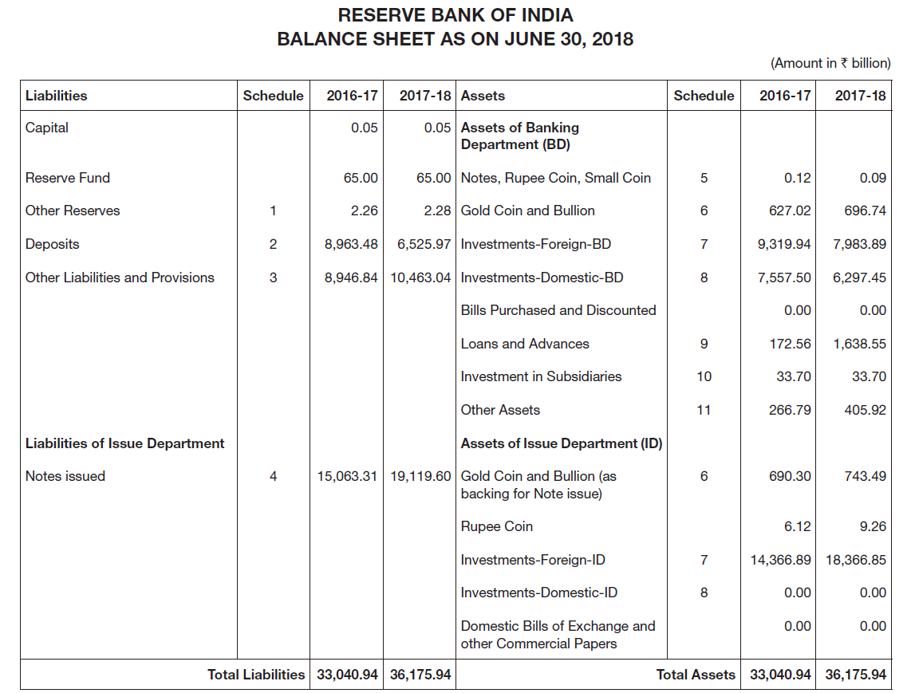

Slide 31
Thank You

